Slide 1






























INDEN evaluation of Fe isotopes &
the ⁵⁵Mn update of thermal (n,γ) gammas
R. Capote (IAEA) and A. Trkov (JSI)
On behalf of the INDEN collaboration
https://www-nds.iaea.org/INDEN

Slide 2
Problems identified in inelastic/capture gammas of many ENDF/B-VIII.0 evaluations
Si(n,n’γ)
Hint:
ENDF/B-VI.8
was better for gammas
Marie-Laure Mauborgne et al, CSWEG 2019 & EPJ WoC 239 (2020) 20007 (ND2019)

Slide 3
Problems identified in inelastic/capture gammas of many ENDF/B-VIII.0 evaluations
⁵⁶Fe(n,γ)
Hint:
ENDF/B-VI.8
was better for gammas
Marie-Laure Mauborgne et al, CSWEG 2019 & EPJ WoC 239 (2020) 20007 (ND2019)

Slide 4
Problems identified in inelastic/capture gammas of many ENDF/B-VIII.0 evaluations
Similar problems:
Si(n,n’γ),
Fe(n,γ), Fe(n,n’γ),
Mg(n,γ), Mg(n,n’γ), Ti(n,γ), Ti(n,n’γ)
Hint:
ENDF/B-VI.8
was better for gammas
Marie-Laure Mauborgne et al, CSWEG 2019 & EPJ WoC 239 (2020) 20007 (ND2019)

Slide 5

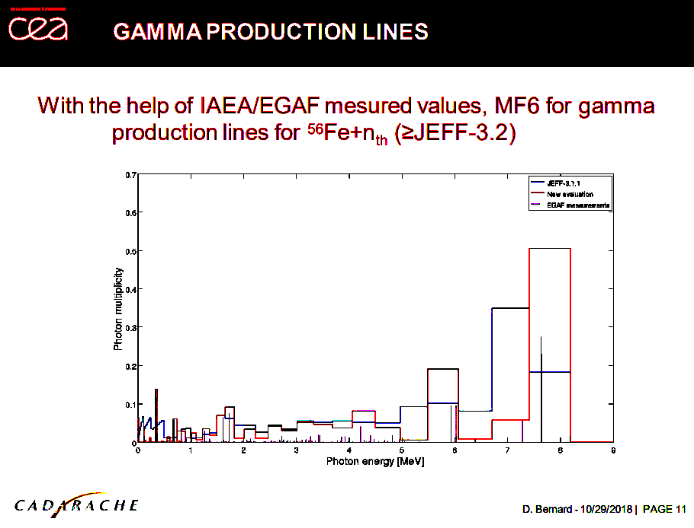
Problems discussed, but not solved

Slide 6
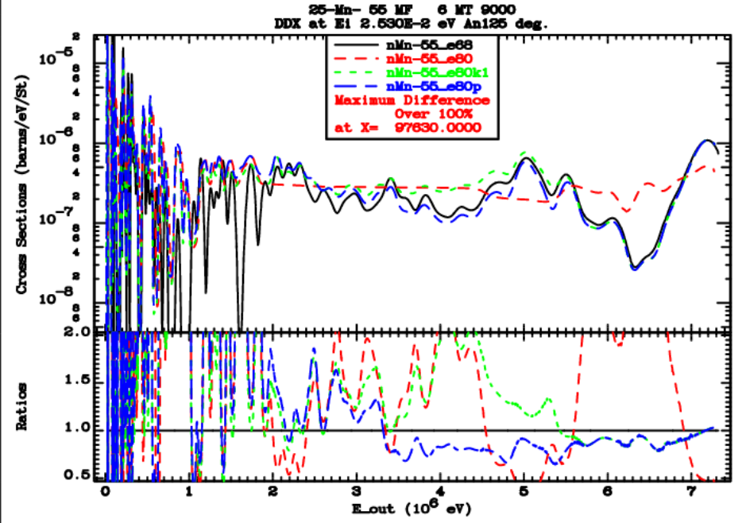
⁵⁵Mn update of thermal (n,γ) gammas
New INDEN files
⁵⁵Mn - case study of the problem

Slide 7
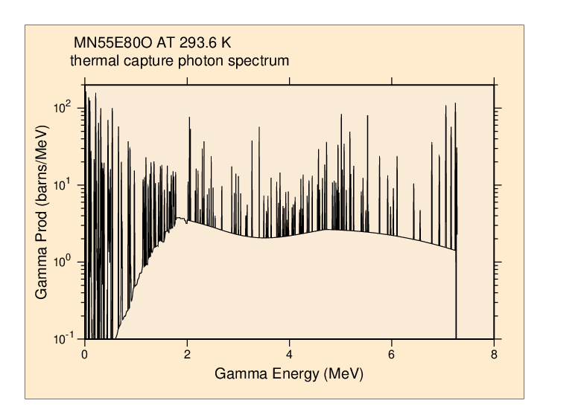
⁵⁵Mn update of thermal (n,γ) gammas
Thermal capture photon spectrum updated
EGAF IAEA database:
Measured thermal capture γ
Quite challenging to
reproduce via modelling
But very well measured ☺,
Let’s use it.
EGAF lines superimposed on a
calculated continuum
See description in INDC(NDS)-0810, performance restored

Slide 8
⁵⁵Mn update of thermal (n,g) gammas
Mn-55 evaluation in ENDF/B-VIII.0 was criticized for poor prediction of capture gamma spectra (Marie-Laure Mauborgne, CSEWG-2019, EPJ WoC 239, 20007 (2020).
The data are important for oil-well exploration.
Using the information in the EGAF library and EMPIRE nuclear model calculations the gamma production data were improved. High resolution energy bins (~5 keV/bin)
Good performance of updated file mn55e80p on proprietary benchmark was confirmed by Marie-Laure Mauborgne
Documented in INDC(NDS)-0810 on "Evaluation of thermal capture gamma spectra"

Slide 9
Problems with ENDF/B-VIII.0 (CIELO) ⁵⁶Fe
Up to 30% underestimation of neutron leakage for En=1-4 MeV
Fig. 32, 35, Nuclear Data Sheets,148 (2018) 214-253

Slide 10
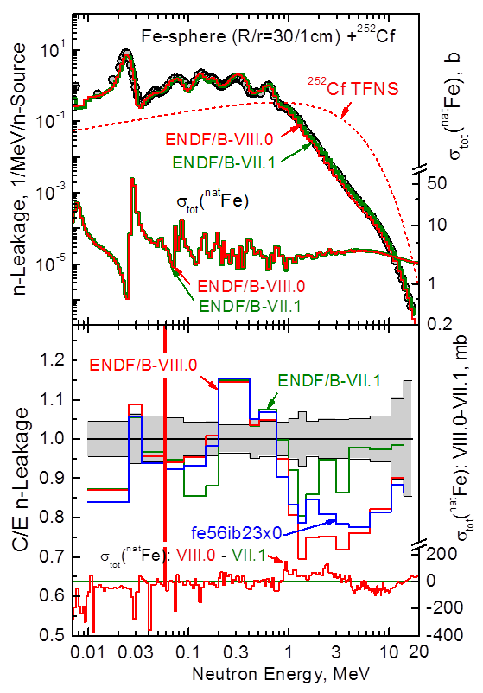
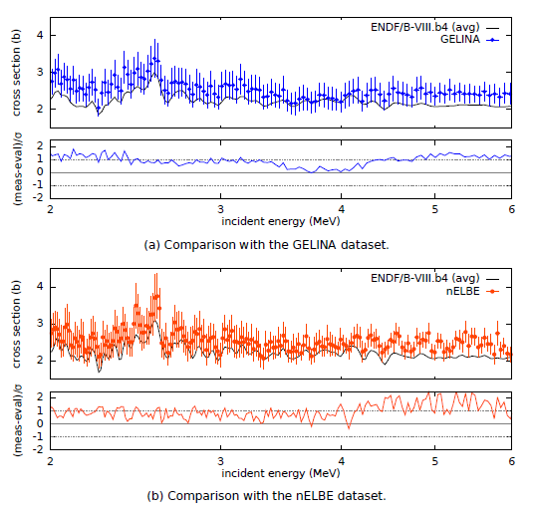
⁵⁶Fe evaluation
New measurements ⁵⁶Fe(n,el)
E. Pirovano et al, JRC Geel

Slide 11
Fe 14 MeV – problem
Indep. confirmation
Polyethylene (C₂H₄)_{n}
Fe
Ф13 cm×6 cm
Ф13 cm×6 cm
Fe
Ф13 cm×6 cm
Y. Ding et al, EPJ WoC 239 (2020) 18010 (ND2019)

Slide 12
²⁵²Cf(sf) neutron leakage: 100 cm sphere
Up to 30% overestimation of neutron leakage for En~300 keV
B. Jansky et al., CVR, Rez, Czechia,EPJ WoC 239 (2020) 18005 (ND2019)
H-proportional detector (HPD)
stilbene detector
Note that ENDF/B-VIII.0 Fe = CIELO

Slide 13
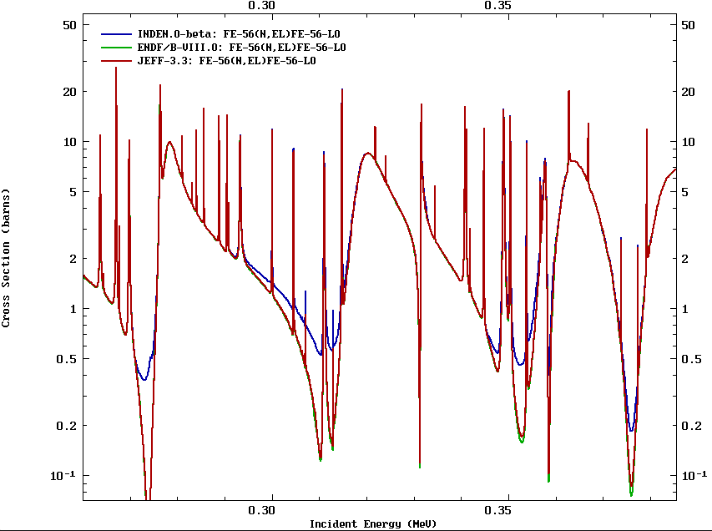
Patching the Fe-56 evaluation: EL (1)
Adhoc increase, NO fit
(n,el) minima poorly described (27 keV,~300keV, ...)
Sensitive to transmission through thick samples (>5 cm)

Slide 14
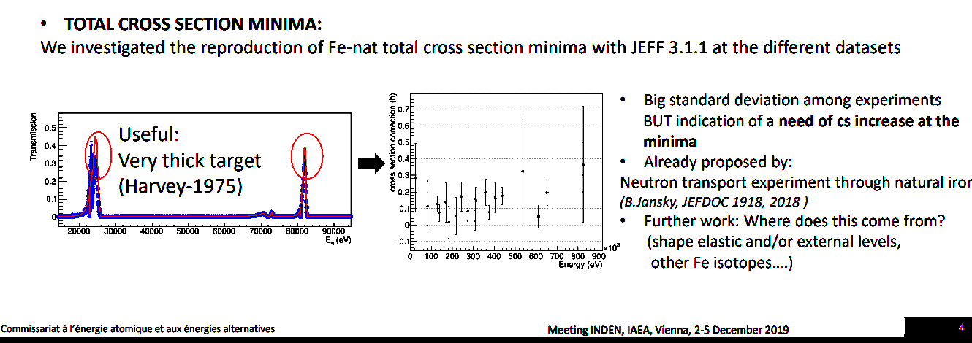
INDEN Fe: Filling the elastic cross-section minima
(relevant for deep penetration problems only)
Solution already tested and suggested by M. Diakaki

Slide 15
²⁵²Cf(sf) neutron leakage: 100 cm sphere
.
.
H-proportional detector (HPD)
stilbene detector
Note that ENDF/B-VIII.0 Fe = CIELO
B. Jansky et al., CVR, Rez, Czechia,EPJ WoC 239 (2020) 18005 (ND2019)
Notes:
A very crowded table?

Slide 16
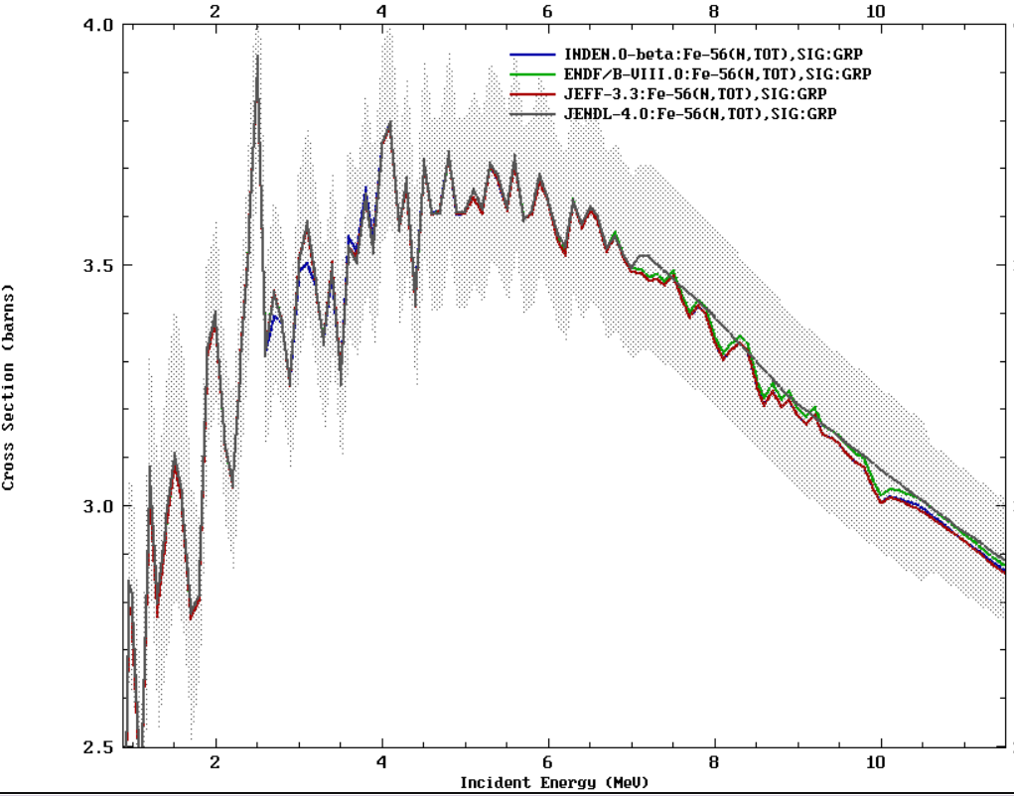
Patching the Fe-56 evaluation: TOTAL

Slide 17
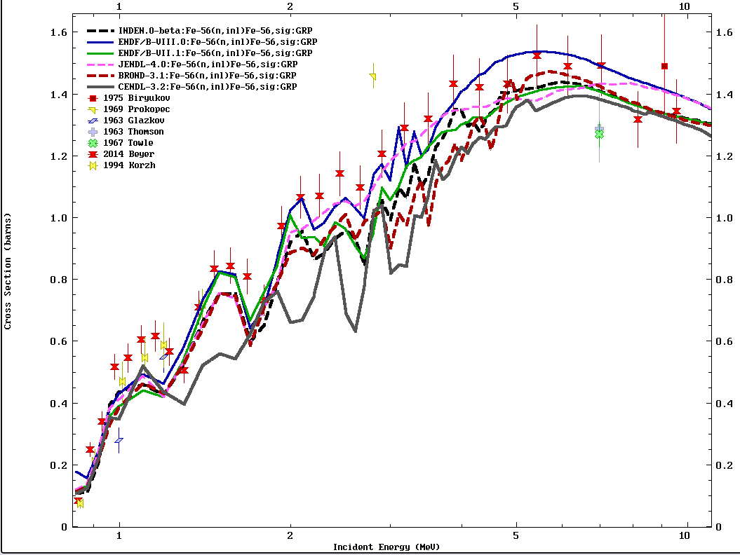
New INDEN files
Patching the ⁵⁶Fe evaluation:
(n,inl)

Slide 18
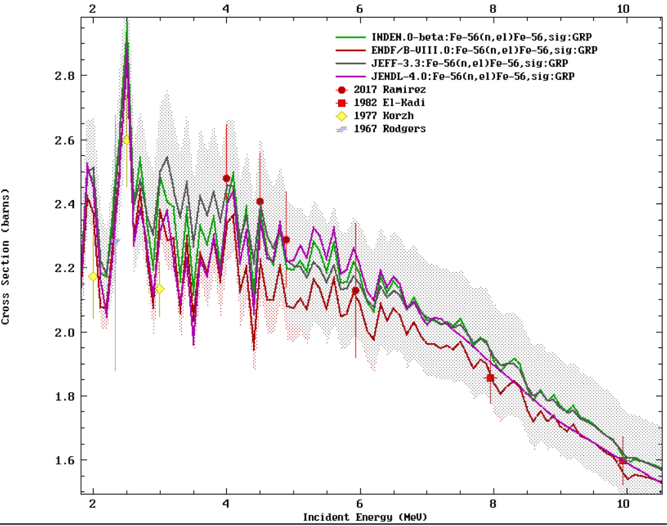
Patching the Fe-56 evaluation: EL (1)

Slide 19
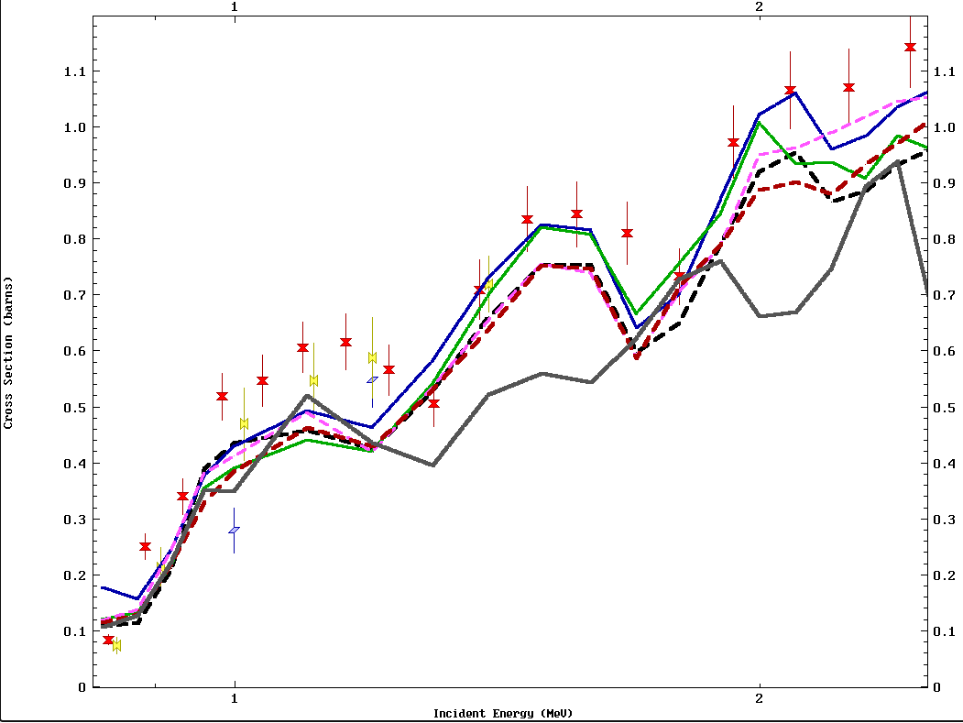
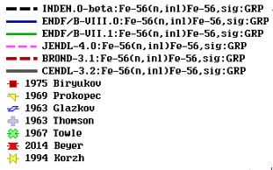
Patching the ⁵⁶Fe evaluation:
(n,inl)

Slide 20
Improvements to ⁵⁶Fe evaluation
Total cross sections are trusted
New measurements by E. Pirovano at IRMM support a higher elastic cross section
Capture is too small to play a role
→Conclusion: measured inelastic likely too high
Inelastic cross section was scaled down by 10-15%, assigning the difference to elastic (exact comparison of cross sections is difficult due to strong fluctuations)
Elastic minima were filled to reproduce observed transmission. A proper R-matrix fit will be appreciated.
Older thermal capture needs to be likely restored

Slide 21
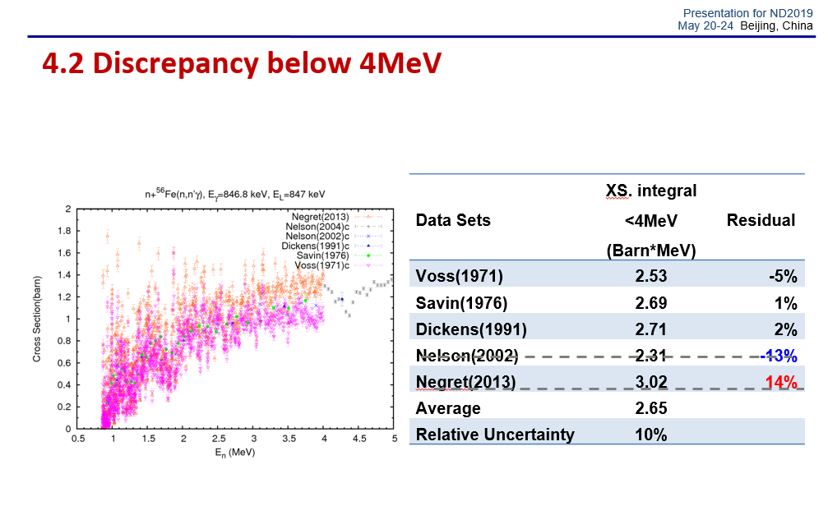
Normalization issue ? Wu H., ND2019

Slide 22
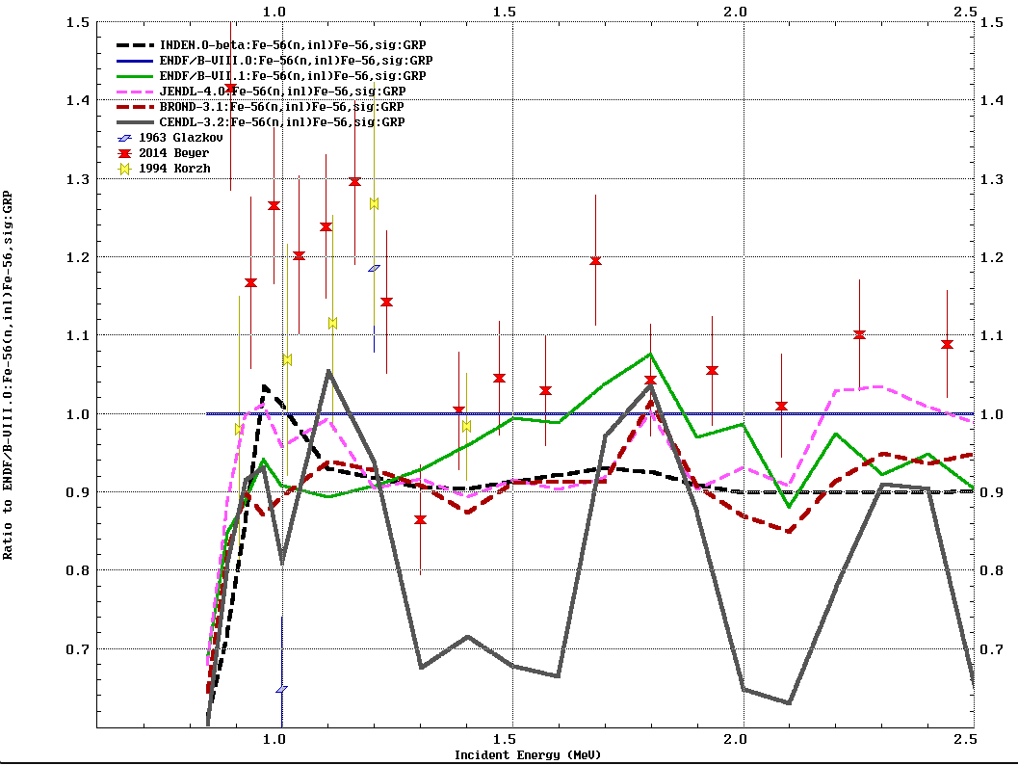
Ratio to -B/VIII.0

Slide 23
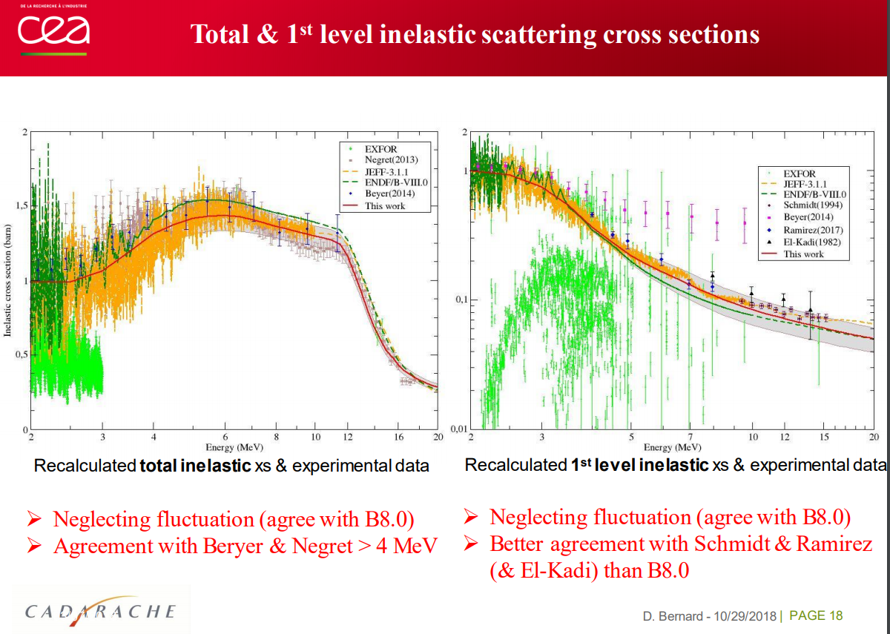
Future improvements of (n,inl)

Slide 24
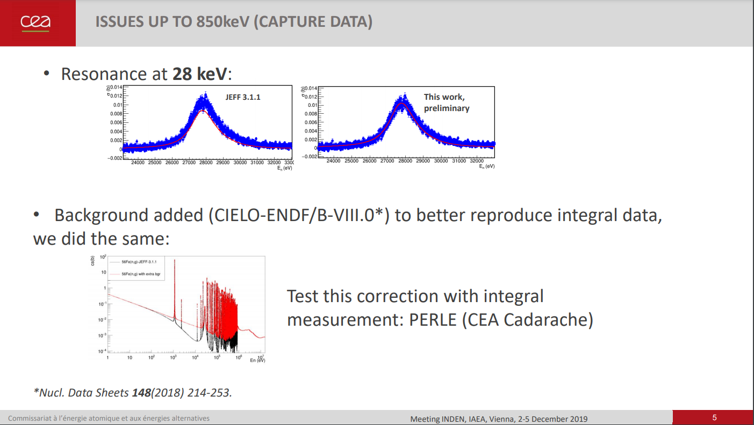
Future improvements: M. Diakaki
to do
1/v backg = Direct capture ?

Slide 25
Changes to ⁵⁶Fe evaluation: (n_{th},g)
Thermal capture JEFF-3.2 = 2.586 b
Thermal capture ENDF/B-VIII.0
= 2.605b (+0.7% rel. to JEFF-3.2)
Firestone et al, Phys. Rev. C95 (2017) 01428
= 2.394±0.019b (-8.0% rel. to JEFF-3.2)
Criticality benchmarks show mixed results (AT)
What is the truth?

Slide 26
Validation of the ⁵⁶Fe thermal capture

Slide 27
Validation of the ⁵⁶Fe thermal capture

Slide 28
Changes to ⁵⁶Fe evaluation: (n_{th},g)
Thermal capture JEFF-3.2 = 2.586 b
Thermal capture ENDF/B-VIII.0
= 2.605b (+0.7% rel. to JEFF-3.2)
Firestone et al, Phys. Rev. C95 (2017) 01428
= 2.394±0.019b (-8.0% rel. to JEFF-3.2)
MAESTRO result:
(C/E-1) Fe = +0.3 (1.1)%
(C/E-1) SS316L (64% Fe, 18%Cr) = -0.7 (1.2)%
Firestone et al (n_{th},g) reduction is not acceptable (>5σ away)

Slide 29
Conclusions
INDEN interactions strongly helped to find deficiencies in existing evaluations and highlight potential solutions to existing challenges: https://www-nds.iaea.org/INDEN/
Reduced inelastic in Fe-56 deserves further experimental and/or theoretical investigations
New R-matrix fit that reproduces fitted minima of the elastic cross-section of Fe-56 desirable and includes direct capture (1/v and above 300 keV)
Additional work needed on inelastic, RRR fits, thermal capture gammas
Updated evaluations for Mn-55, Fe-56, and Fe-57 (inelastic) are available for testing.
See Trkov presentation for additional validation
Mn-55 updated evaluation was tested on a relevant proprietary benchmark. Significant improvement was demonstrated.

Slide 30
DA fluctuations and smoothing: P₀ (E) ≡ σ_{el}

Slide 31
DA fluctuations and smoothing: P₁(E) ≡ μ_{el}

Slide 32
DA fluctuations and smoothing: P₂(E) ≡ ξ_{el}

Slide 33
DA: 500 keV
DA: 500 keV
DA: 800 keV
DA: 800 keV

